Slide 1
Storyboards & Film Planning
Linguacuisine Workshop 4

Slide 2
Story Board
Storyboard takes a script and plans individual shots
Shots
Determine camera edits
Describe camera position / movement
Describe lighting etc.
Link back to script elements

Slide 3
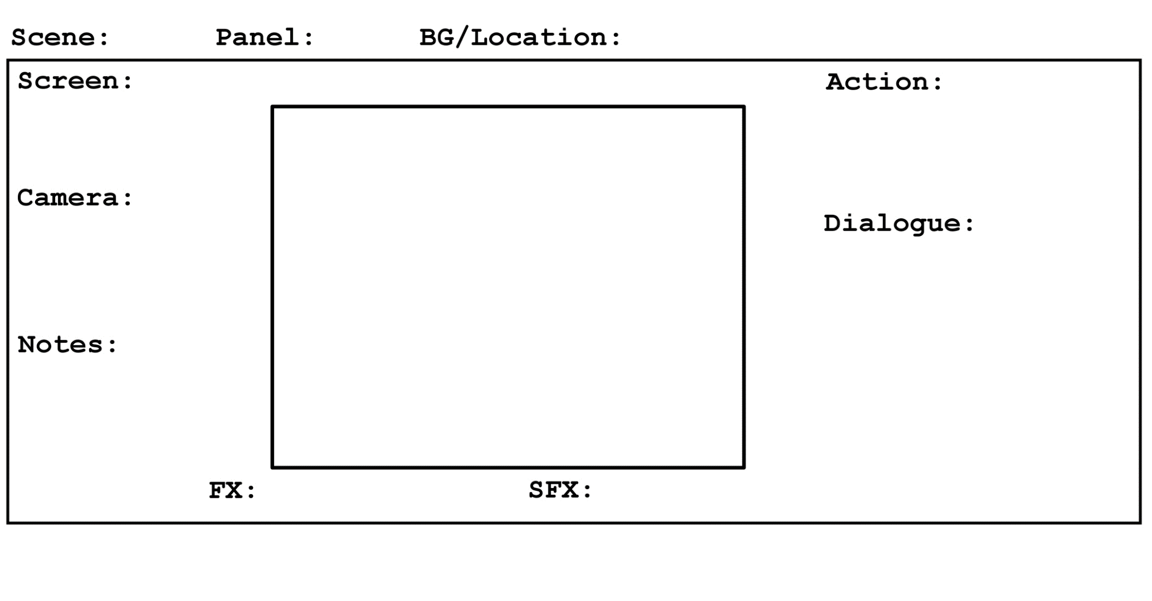
Storyboard Elements

Slide 4
Storyboard Elements
Number: New Edit Point
Number: Camera Change without Edit (e.g. Move)
Description of Shot/Scene Location
Description of Screen (e.g. wide screen, 4:3)
Description of what’s going on in scene / shot
Description of Camera Shot (e.g. Close-up)
Picture of scene
What (if anything) is being said (include emphasis)
Extra details if needed
Visual effects
Audio Effects

Slide 5
Storyboard Elements Example

Slide 6
Camera
Camera Distance
Long
Medium
Close-up
Transformed via zoom
Camera Angle
High
Low
Dutch
Camera Movement
Tripod (rotation)
Dolly (forward-back, side to side, diagonal)
Crane
Combinations (e.g. zoom + dolly = vertigo)

Slide 7
Example Video
https://www.youtube.com/watch?v=4316BUEVYkE

Slide 8
Exercise One:
Create a storyboard for the following video:
https://www.youtube.com/watch?v=gHdDxKy2QW0

Slide 9
Exercise Two:
Create a storyboard for the following video:
https://www.youtube.com/watch?v=k_mpaF5-SlU

Slide 10
Recipe Storyboard Brief
We will be taking the storyboard into the next session…
Make storyboard for a ~1 min film of a recipe
Language neutral (no dialogue!)
Footage should be of preparation and cooking (i.e. not shopping)
Choose something filmable in a normal kitchen (no stuntmen or CGI allowed)

